Slide 1
CLUSTERING LOCATIONS OF TOP 100 RESTAURANTS OF CANCUN WITH A MACHINE LEARNING APPROACH
MARIO EMMANUEL RODRIGUEZ TREJO May 20th, 2019

Slide 2
Clustering restaurants locations from different categories
In Quintana Roo, the sector that has more participation in the GDP is the "food and beverages" SMES with a contribution of 21.3% in the state (INEGI,2014). According to the UNWTO, the city that gives more GDP among others is Cancun with 7.1% (La Jornada Maya, 2018).
The bankruptcy index of SMES in México grows up to 80% after 5 years of operations (El Universal, 2016)

Slide 3
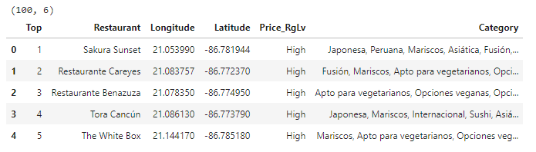
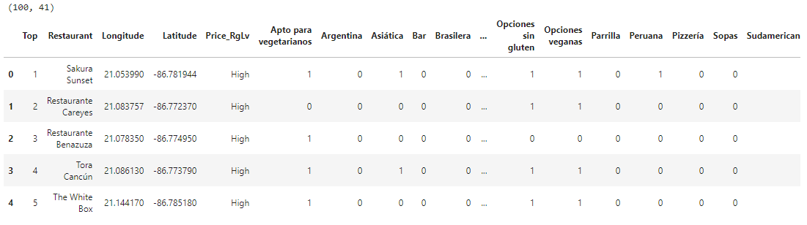
Data obtention from Trip Advisor

Slide 4
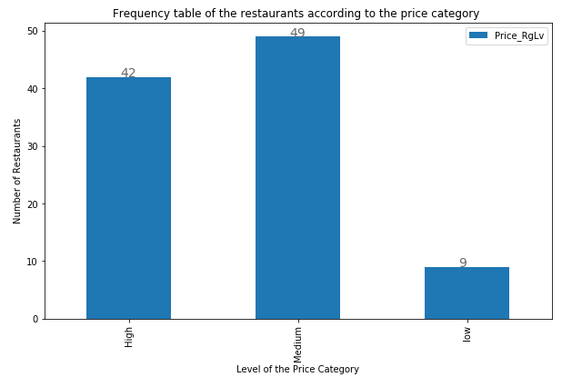
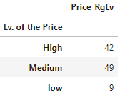
Price level categories frequencies

Slide 5
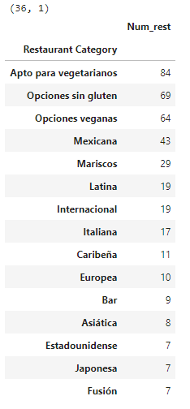
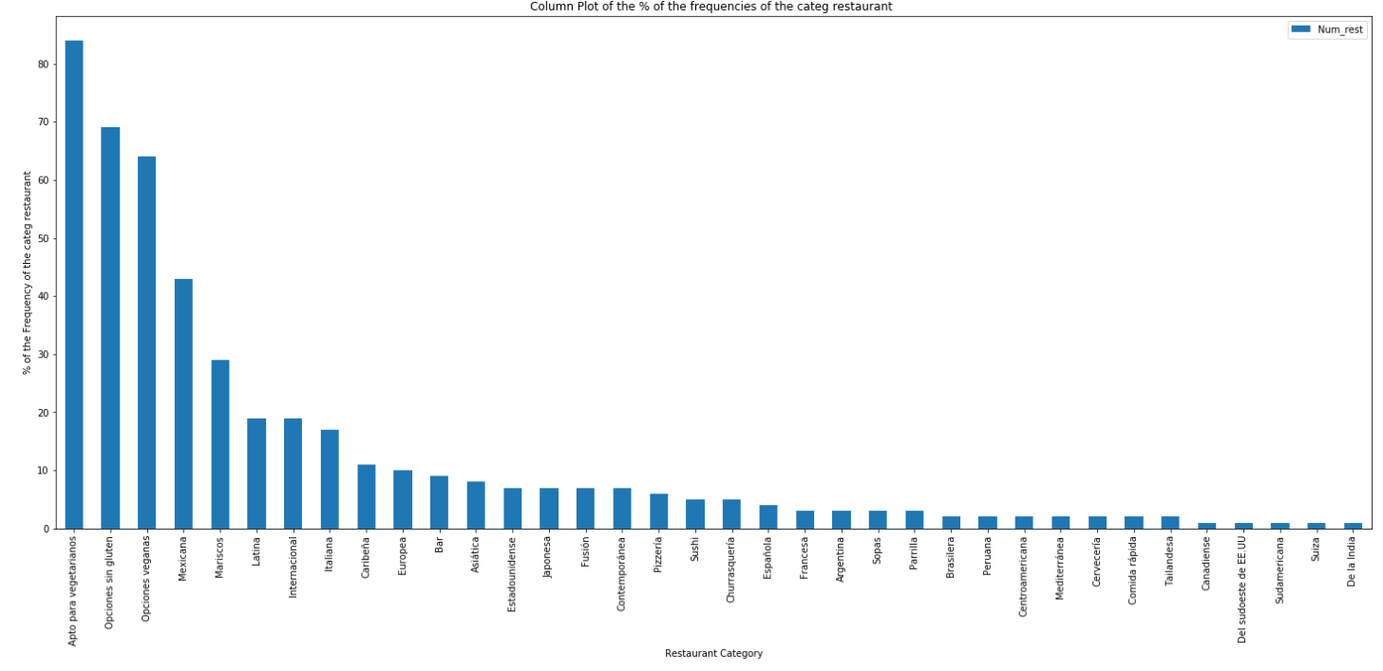
Restaurants categories frequencies

Slide 6
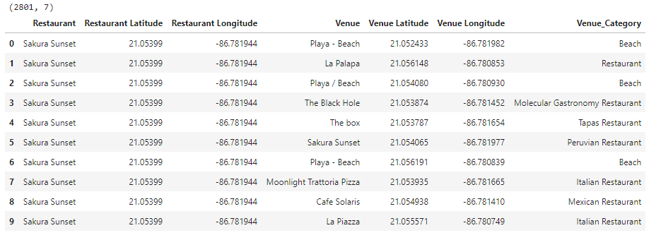
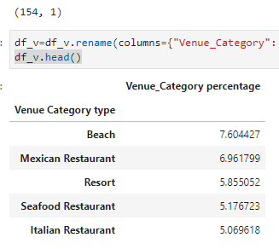
Venues obtention and frequencies calculation

Slide 7
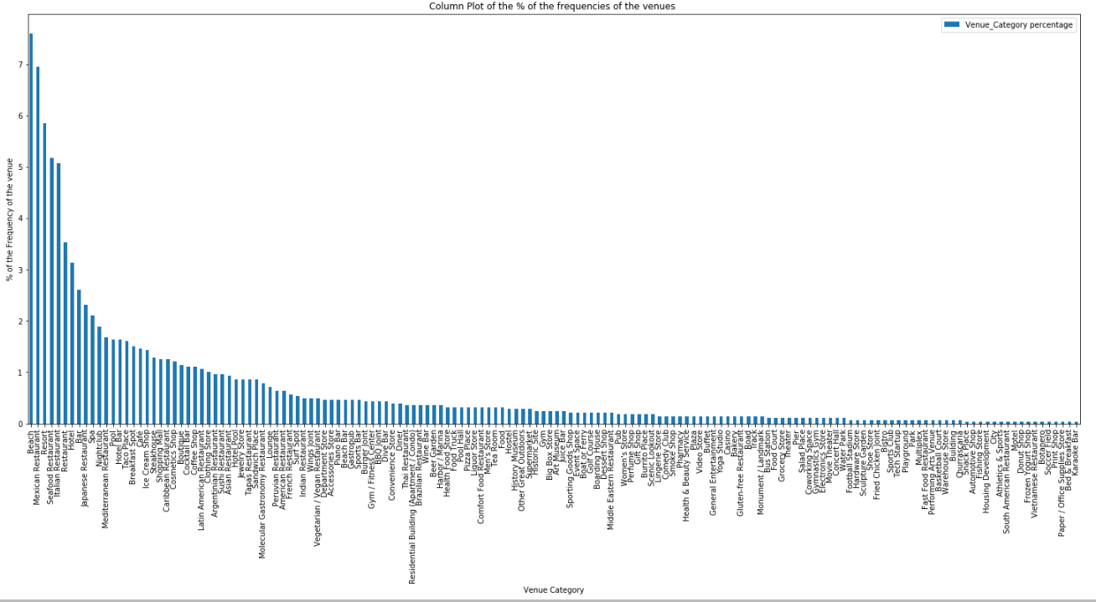

Slide 8
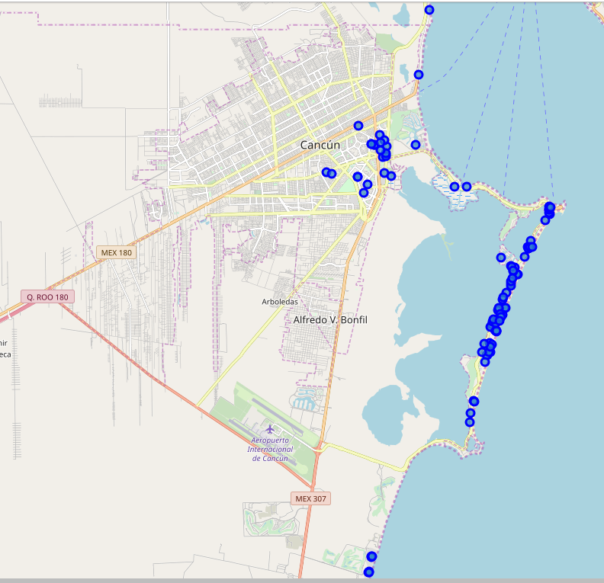

Slide 9
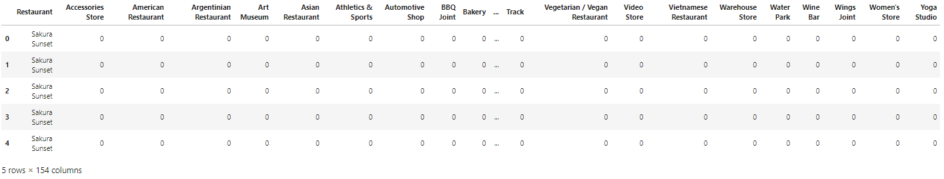
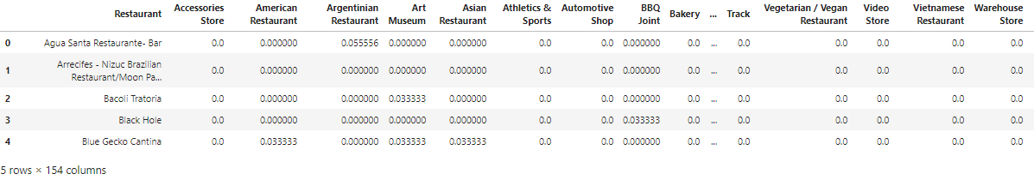
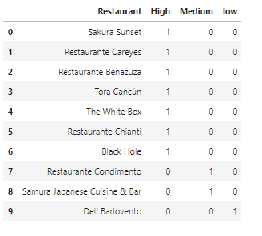
One hot encoding technique

Slide 10
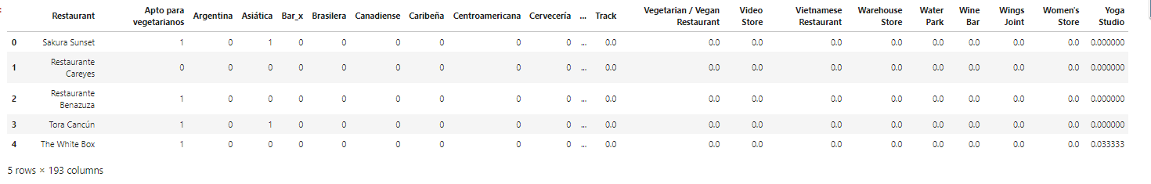
Merged table of all prepared data for the model

Slide 11
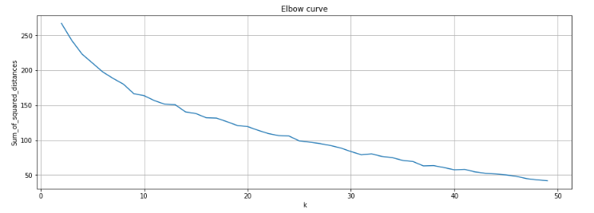
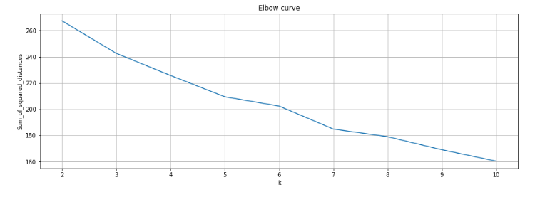
Elbow method

Slide 12
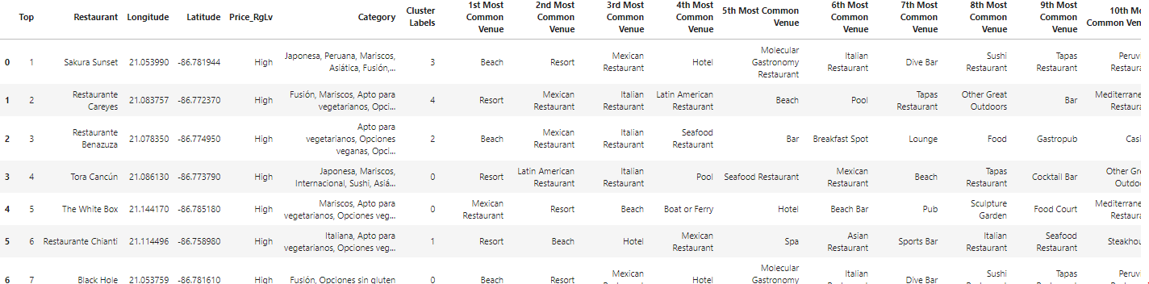
Sample of merged categories with defined clusters

Slide 13
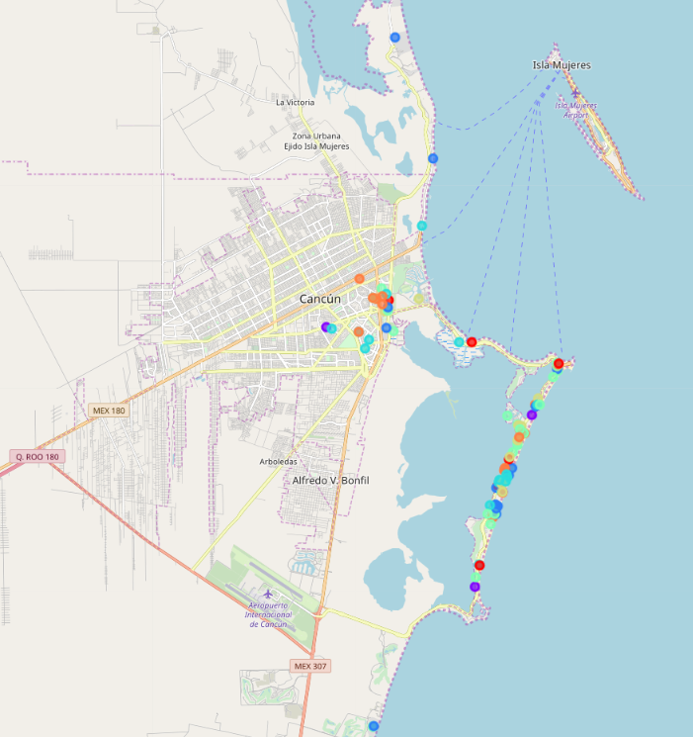

Slide 14
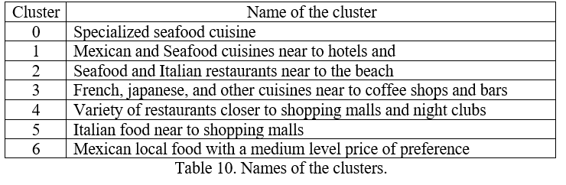
Named clusters in a table

Slide 15
Conclusion
Seven clusters defined how Small and Medium Enterprises of “Food and beverages” should be labeled with the k-means algorithm. The results are clearly an insight for decision makers and researchers with the main features that the author thought and searched that have consistency where the name of the clusters can be discussed with experts of the area.
For next researches in this topic or related areas, it is recommended to always use data that can be available and not dynamic due to lack of consistency on the features. Furthermore, the model could be more precise if an adaptive web scrapping program can be used in TripAdvisor website to get the information of the majority of the available restaurants.

